Slide 1

Global Electronics Project Presentation
Presented By
Harikrishna Panneerselvam
Batch:MDTM29

Slide 2
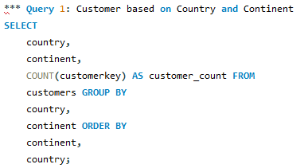
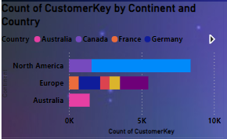
Visual Representation :1
Insights about Query No:1
The image shows the distribution of customers across different continents and countries.
North America has the highest overall count of customers, followed by Europe. Australia has the lowest.
Within North America:
Canada has the highest count of customers.
France has the second-highest count.
Germany has the lowest count in North America.
Within Europe:
France has the highest count of customers.
Germany has the second-highest count.
Australia:
Australia has the only data point, indicating it might have a limited customer base compared to the other continents.
Overall, the customer base is concentrated in North America and Europe, with Australia having a significantly smaller presence. This suggests that the business might want to focus on expanding its customer base in Australia or explore opportunities in other regions.

Slide 3
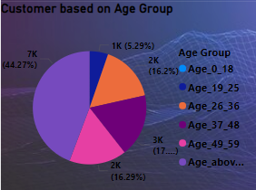
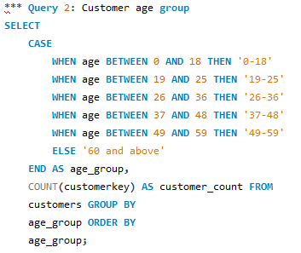
Visual Representation :2
Insights about Query No:2
Dominant Age Group: The age group of Above 60 represents the largest segment of the customer base, comprising 44.27% of the total. This indicates that this demographic is the most significant driver of customer acquisition and retention.
Moderate Representation: The age groups of 37-48, 49-59, and above 26-36 moderate share of the customer base, ranging from 15.22% to 17.95%. These groups contribute significantly to the overall customer population.
Minimal Representation: The youngest age groups, 0-18 and 19-25, have the smallest representation in the customer base, accounting for 5.29% respectively. This suggests that the product or service being analyzed may not be as appealing to younger consumers.
Potential Implications
Targeted Marketing: Businesses can focus their marketing efforts on the 37-48 age group, tailoring their campaigns to resonate with their interests, values, and lifestyle.

Slide 4
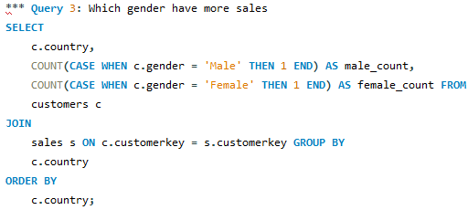
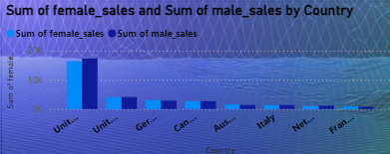
Visual Representation :3
Insights about Query No:3
Female-Dominated Sales: In most countries, female sales significantly outnumber male sales. This trend is particularly evident in the United States and the United Kingdom, where female sales are significantly higher than male sales.
Male-Dominated Sales: The only country where male sales exceed female sales is the Netherlands. This suggests that the market dynamics or cultural preferences in the Netherlands may be different compared to other countries.
Consistent Gender Gap: The gender gap in sales is relatively consistent across most countries, with female sales consistently higher than male sales. This suggests that there may be underlying factors or trends that influence this pattern.
Regional Variations: While the overall trend shows female dominance, there may be regional variations or differences in specific product categories or industries. Further analysis would be required to identify such variations.
Marketing Strategies: Businesses can tailor their marketing strategies to target specific genders based on the observed sales patterns. For example, in countries with higher female sales, campaigns could be designed to appeal to women.

Slide 5
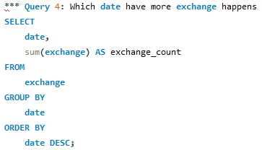
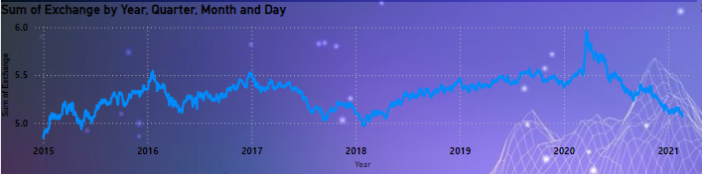
Visual Representation :4
Insights about Query No:4
Overall Trend: The graph shows an upward trend in the sum of exchange over the period from 2015 to 2021. This suggests that the overall volume of transactions or the value of goods exchanged has been increasing over time.
Fluctuations: While there is an upward trend, the graph also exhibits significant fluctuations. This indicates that there are factors influencing the sum of exchange that cause it to vary over shorter periods. These fluctuations could be due to seasonal variations, economic conditions, market events, or other factors.
2020 Spike: A notable spike in the sum of exchange occurred in 2020. This could be attributed to various factors, such as increased online shopping during the COVID-19 pandemic, government stimulus packages, or other economic factors.
Seasonal Patterns: The graph suggests that there may be seasonal patterns in the sum of exchange. While not as pronounced as the overall trend, there appear to be slight fluctuations that repeat annually. This could be due to factors like holiday shopping, end-of-year sales, or seasonal production cycles.
Potential Implications for Global Electronics Sales:
Growing Market: The upward trend in the sum of exchange indicates a growing market for global electronics. This suggests that demand for electronics products has been increasing over time.

Slide 6
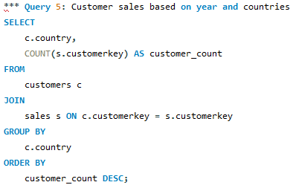
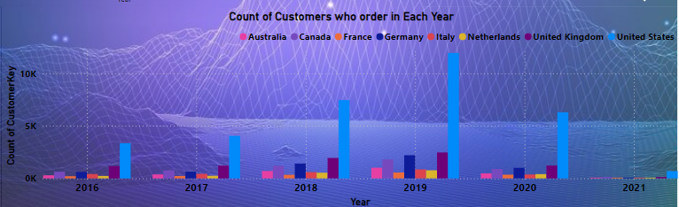
Visual Representation :5
Insights about Query No:5
Overall Growth: The graph shows an overall increase in the number of customers who placed orders across all countries from 2016 to 2021. This indicates a growing customer base for the business.
Country-Specific Trends: While there is an overall upward trend, the growth rates vary among countries. Some countries, such as the United Kingdom and the United States, experienced significant increases in customer orders, while others like Australia and Canada showed more moderate growth.
Peak Years: The years 2019 and 2018 appear to be peak years in terms of customer orders. This could be attributed to various factors, such as economic conditions, marketing campaigns, or product launches.

Slide 7
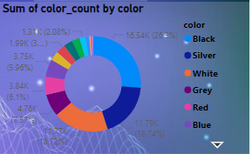
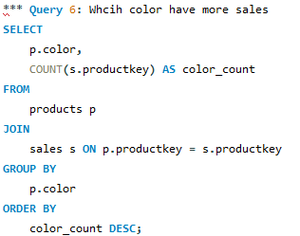
Visual Representation :6
Insights about Query No:6
Dominant Colors: Black, Silver, White and Grey together account for a significant portion of the total color count, making up 54.62% of the total. This indicates that these colors are the most prevalent in the dataset being analyzed.
Moderate Representation: Several colors, including Red, Yellow, and Blue, have a moderate share of the color count, ranging from 5.96% to 7.57%. These colors contribute significantly to the overall diversity of the data.
Minimal Representation: Black, Silver, Grey, Brown, Gold, and Orange have the smallest representation in the color count, each accounting for less than 5%. This suggests that these colors are less common or less frequent in the dataset.

Slide 8
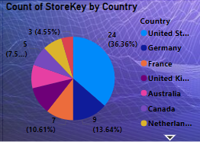
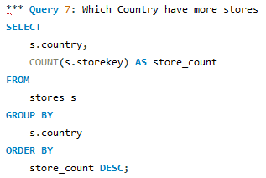
Visual Representation :7
Insights about Query No:7
Dominant Country: The United States has the largest number of StoreKeys, representing 36.36% of the total. This indicates that the business has a significant presence in the United States market.
Moderate Representation: Several countries, including Germany, France, Australia, and Canada, have a moderate share of StoreKeys, ranging from 7.58% to 10.61%. These countries contribute significantly to the overall business operations.
Minimal Representation: The United Kingdom, Netherlands, and Italy have the smallest representation of StoreKeys, each accounting for less than 11%. This suggests that the business may have a limited presence or market penetration in these countries.
Market Expansion: The data suggests that there is potential for the business to expand its operations in countries with a smaller number of StoreKeys, such as the United Kingdom, Netherlands, and Italy.

Slide 9
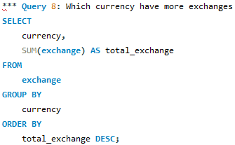
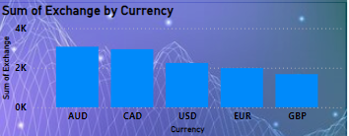
Visual Representation :8
Insights about Query No:8
Australian Dollar (AUD) Dominance: The Australian Dollar (AUD) has the highest sum of exchange, indicating that it is the most frequently used or valuable currency in the dataset.
Canadian Dollar (CAD) and United States Dollar (USD) Similarity: The CAD and USD have similar sums of exchange, suggesting that they may be used interchangeably or have comparable economic significance in the context of the data.
Euro (EUR) and British Pound (GBP) Following: The EUR and GBP follow closely behind AUD, CAD, and USD, suggesting that they are also significant currencies in the dataset.

Slide 10
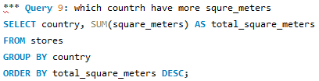
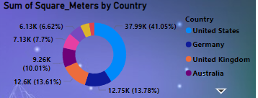
Visual Representation :9
Insights about Query No:9
Dominant Country: The United States has the largest sum of square meters, representing 41.05% of the total. This indicates that the United States has the most extensive area or holdings compared to the other countries.
Moderate Representation: Several countries, including Germany, the United Kingdom, Australia, and Canada, have a moderate share of square meters, ranging from 10.01% to 13.78%. These countries contribute significantly to the overall total.
Minimal Representation: Netherlands, Italy, and France have the smallest representation of square meters, each accounting for less than 7%. This suggests that these countries have a limited area or holdings compared to the other countries.

Slide 11
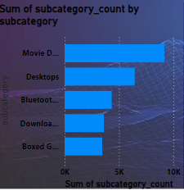
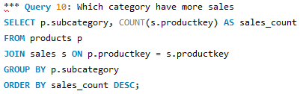
Visual Representation :10
Insights about Query No:10
Dominant Subcategory: Movie DVDs have the highest sum of subcategory count, indicating that they are the most popular or frequently purchased product category.
Descending Popularity: The other subcategories (Desktops, Bluetooth Headphones, Download Games, and Boxed Games) have decreasing sums of subcategory count, suggesting that their popularity or sales volume is lower than Movie DVDs.
Potential Implications.
Product Strategy: The dominance of Movie DVDs may indicate a need to focus on this category or explore opportunities to expand into related product lines.
Inventory Management: Understanding the popularity of different subcategories can help businesses optimize their inventory levels and ensure they have sufficient stock of in-demand products.
Marketing Efforts: Businesses can prioritize marketing efforts for subcategories with lower sales volume to drive demand and increase their popularity.

Slide 12
Thanking You

